Slide 1

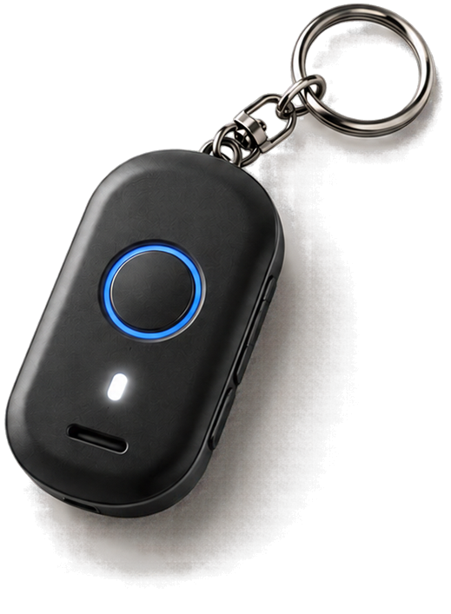









Team Gamma
Colossal-a-Pitch
Avinya 26
APRAJITA
THE SURAKSHA KEY
When danger strikes, reaching for a phone can be too slow or impossible.
Existing safety systems rely on phones, GPS, and connectivity, which may fail when they matter most.
Women need a discreet way to signal, share their location, and get help instantly.
Because in an emergency, every second and every signal matters.
Discreet SOS
Smart Location
Rapid Response
TEAM MEMBERS
Aditya Rana
Sakshi Garg
Yash Mathur
Avani Tiwari

Slide 2


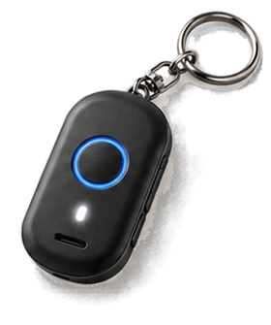





























Team Gamma
Colossal-a-Pitch
Avinya 26
Our Idea:
PROBLEM
SURAKSHA KEY transforms an everyday keychain into a low-cost, offline-first safety lifeline. A discreet double-press or a sudden jerk triggers SOS , with GPS, SafeNodes and last-known location helping identify the user's location even indoors. Silent vibration confirms the alert,. The system can notify trusted contacts and security, with false-alarm protection and rapid response tracking designed to stay useful even when phone access or internet connectivity is limited.
STATEMENT
When danger strikes, reaching for a phone can be too slow or impossible.
Existing safety systems rely on phones, GPS, and connectivity, which may fail when they matter most.
3-STAGE EMERGENCY ACTIVATION
DISCREET → VISIBLE RESPONSE
Women need a discreet way to signal, share their location, and get help instantly.
01
1st Press → Activate + 2nd Press → SOS
• Emergency SMS + 3rd Press → Buzzer + Flash
04
Start silently with an emergency signal,
then escalate to buzzer when attention is needed.
A progressive alert system gives the user control over how urgently to respond.
Because in an emergency, every second and every signal matters.
→ One device, multiple levels of response.
INTEGRATED GPS + 4G
OFFLINE-FIRST SAFETY
02
Built-in GPS captures location, while 4G sends SOS and emergency information to the response system.
05
When 4G connectivity is unavailable, the system can retain last-known location and emergency status until communication is restored.
→ No need to depend on the phone for triggering the alert.
03
SAFENODE INDOOR SUPPORT
Discreet SOS
Smart Location
Rapid Response
SafeNodes help identify the user's location/zone when GPS is unreliable indoors.
→ Extends location awareness beyond outdoor GPS.

Slide 3





























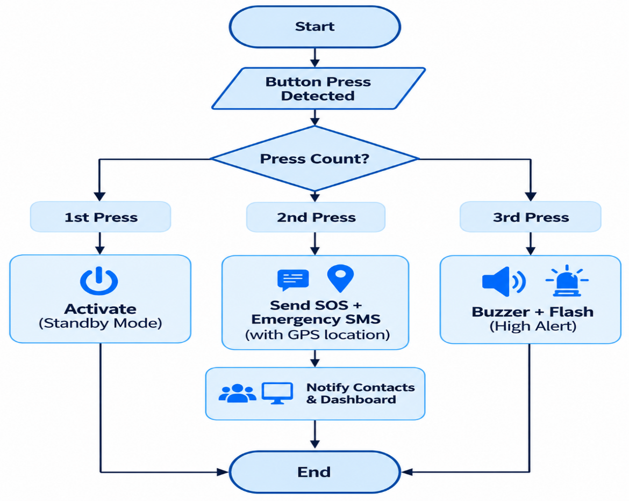
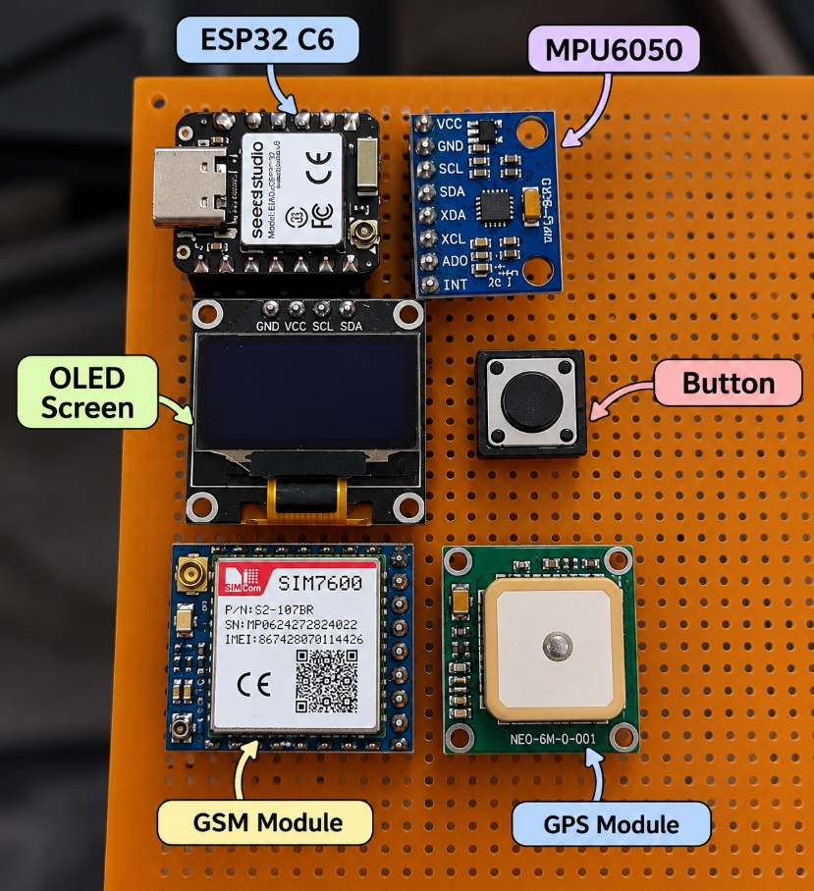








Team Gamma
Colossal-a-Pitch
Avinya 26
TECHNICAL
System Architecture:
APPROACH
Push Button
Buzzer
(3-Stage Trigger)
(Audible Alert)
GPS Module
Technology Used:
(Real-Time Location)
Flash Light
ESP32
(Visual Alert)
ESP32 – Core Controller
Acts as the brain of SURAKSHA KEY, processing button inputs, sensor data and managing the emergency sequence. Controls GPS, 4G, MPU6050, buzzer, and vibration modules.
A7670C 4G
(Core Controller)
(Communication)
Vibration Motor
(Silent Feedback)
MPU6050
A7670C 4G – Communication Module
Provides a loud buzzer to transmit SOS alerts, emergency SMS and GPS location. Enables direct communication without relying on the user's smartphone.
(Motion/Fall Detection)
Mobile App + Dashboard
(Location Tracing & Alerts)
GPS Button – Emergency Alert
Captures the user's latitude and longitude during an emergency. Provides location data for SOS alerts, live tracking and rapid response.
Flow Chart (3-Stage SOS):
Prototype / Hardware Model:
MPU650 – Motion & Fall Detection
Detects sudden jerks, falls or abnormal motion patterns to automatically trigger the emergency sequence.
Push Button – 3-Stage SOS Trigger
Detects sequential prizes to activate, trigger SOS, and escalate the emergency alert. Provides simple, fast and discreet control.
Buzzer & Lich – Emergency Alert
Activates a loud buzzer to activate the emergency
escalation. Provides instant audible and visible attention.
Mobile App + Dash-Board – Emergency Monitoring
The app shares location, manages trusted contacts and tracks active SOS alerts. The dashboard gives authorized responders real-time alerts, location and emergency status for faster action.

Slide 4

































Team Gamma
Colossal-a-Pitch
Avinya 26
AI MEMORY LAYER
- HINDSIGHT
Remembers, learns and personalizes your safety experience.
What is Hindsight?
How it Works in Aprajita
Key Features
Hindsight (by Vectorize) is an AI memory system that helps the app remember important information, past events and user preferences over time, so it can provide a personalized and context-aware safety experience.
Remembers your details
Trusted contacts, emergency protocols, and safety settings.
Device
Flutter App
User Data
SOS, location,
motion alerts
Settings, chat, check-ins
Contacts,
routines, preferences
Learns your routine
Regular routes, commute timings and frequent locations.
Retain
Store important information
(e.g., preferences, contacts).
Hindsight
Uses past incidents
(AI Memory Layer)
Stores past SOS events and device history to give relevant support.
Recall
Find relevant past information when needed.
More Personalized Safety
Proactive suggestions
Reflect
Remembers your information, understands your context and provides proactive assistance.
Suggests check-ins and alerts for unusual or risky situations.
Understand patterns and give smarter, proactive suggestions.

Slide 5
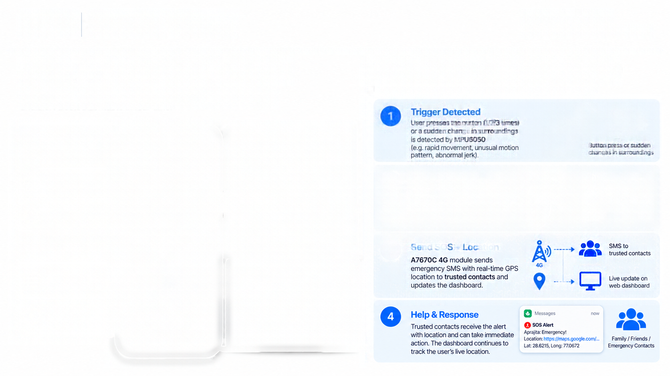



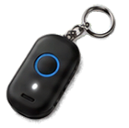



























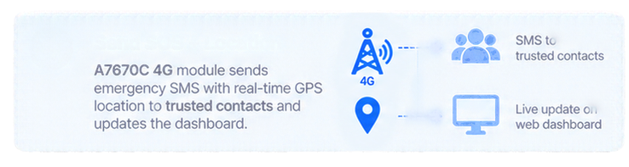














Team Gamma
Colossal-a-Pitch
Avinya 26
APP &
DASHBOARD
WORKING SCENARIO
A simple and intuitive interface to manage safety, track location, and alert trusted contacts in real-time.
From detection to response — a complete safety chain.
1
Trigger Detected
Hindsight
Ai agent
User presses the button (1/2/3 times) or a sudden change in surroundings is detected by MPU6050 (e.g. rapid movement, unusual motion pattern, abnormal jerk).
Mobile App (User)
View real-time
location
Aprajita
Real Time location based updates
Button press or sudden changes in surroundings
Your Safety Companion
View and decide which contact to use
Manage trusted contacts
2
Emergency Activated
Buzzer (Audio)
SOS
Send alert on the basis of past learning
ESP32 processes the trigger and activates buzzer, flash and vibration for user feedback.
Flash Light (Visual)
Receive SOS
alerts & notifications
Generates a summary of each SOS or a false alarm
Vibration (Haptic)
Press and hold to activate
Live Location
Automatic checkins based on area history or the mode selected
Live tracking on map
Updated 10 sec ago
3
View device status (battery, network, GPS)
Aprajita
Active Alet
User Details
Active Alert
Active Alert
User 01
Active Alert
Status
SOS Active
Vikaspur, New Delhi
Users
SOS
Active Alert
Settings & history of alerts
Lat 28.5215, Long 77.0672
Location history
Restore
10:24 AM
Settings
Time
View Live Location
Contacts
History
Settings

Slide 6













Team Gamma
Colossal-a-Pitch
Avinya 26
FEASIBILITY
VIABILITY
Our solution is technically, operationally and legally feasible using readily available components and existing infrastructure.
A sustainable and impactful solution with strong potential for real-world adoption and long-term use.
Technical
Business Model
  Built using widely available and tested components (ESP32, A7670C 4G, GPS, MPU6050, etc.).
  Real-time location and motion detection using proven technologies.
  Can be developed and replicated at low cost.
  Direct sale to individual users (students, working professionals, travelers).
  Tie-ups with schools, colleges, organizations and NGOs.
  Potential government partnerships for large-scale deployment.
Societal Impact (India)
Operational
Reported crimes against women in India (NCRB, 2022)
A crime against a woman is reported
  Simple to use with a single button and automatic trigger.
  Works in real-world conditions with cellular network (4G) and GPS.
  Requires minimal user training.
  Easy to maintain and scale.
93,000
every 3 minutes
in India.
44,445
Regulatory
28,045
Over 93,000 cases is reported against women were reported in 2022 (NCRB, 2022).
  Compliant with India's data privacy law (DPPD Act, 2023).
  Uses licensed SIM module (A7670C) for SMS/4G.
  Can integrate with existing emergency helplines (112) and local authorities.
2020
2021
2022

Slide 7





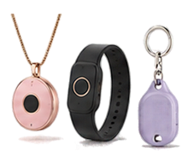









Team Gamma
Colossal-a-Pitch
Avinya 26
MARKET
& GO-TO-MARKET
MARKET SIZE (INDIA)
CUSTOMER # CONSUMER
MAKE SAFETY A
Large and growing market for personal safety solutions in India.
Different stakeholders, both important for adoption and scale.
FASHION ACCESSORY
A functional safety device that looks good and fits into everyday life.
TAM
$34.96M
TAM
CUSTOMER / PAYER
$34.96M
  Parents, partners and family members buying for their loved ones.
  Colleges, employers and organizations procuring for groups (students, employees).
  NGOs and community programs for large-scale deployment.
India personal safety alarm market
(2025 estimate)
Style options
  keychain, bag charm and more.
  Multiple colours and replaceable shells.
  Discreet, lightweight and comfortable design.
SAM
$21.87M
SAM
$21.87M
Standarden alarm segment
(2025 estimate)
SOM
$0.22M
CONSUMER / END USER
Go-to-market strategy
SOM
  Women and girls.
  Women and their professionals and travelers.
  Wear and use the device in daily life for personal safety.
  Campus pilots and college partnerships.
  Parent/family gifting as a safety essential.
  Partnerships with schools, employers and NGOs.
  Collaborations with women creators and influencers.
  Direct-to-consumer website and online marketplaces.
  Community safety workshops and awareness drives.
$0.22M
Illustrative 1% initial capture target of SAM
CORE ADVANTAGES
SOS trigger without a phone
SMS does not need mobile data
GPS-based location assistance
Buzzer, flash and vibration
Works with a dedicated button and motion-based trigger.
Uses cellular network (SMS/4G).
Does not require an internet plan, but cellular signal is required.
When satellite fix is available.
Saves last-known location and retries after coverage returns.
Layered alerts for faster response and nearby attention.

Slide 8




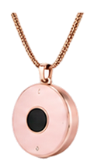
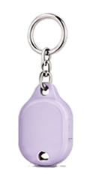

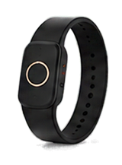













Team Gamma
Colossal-a-Pitch
Avinya 26
BUSINESS
MODEL & REVENUE
Affordable device with value-added services for long-term, recurring revenue.
Device Pricing
Subscription Plans (Optional)
Target Customers
Advanced features for higher safety and convenience.
Individual Users
Premium (Subscription)
Women and girls (students, working professionals, travelers).
₹99/month
₹999/year
Server-based calling (even if phone not available)
Parents & Families
Complete access to agent with hindsight
Buy for their loved ones.
₹3,000
Night travel & travel-alone mode (smart alerts, check-ins with hindsight)
Institutions
One-time purchase
Location history and safe-zone alerts
Schools, colleges, hostels, companies (employee safety), NGOs and government programs.
Includes device, basic features and 1 year warranty.
Priority support and additional features
Other Revenue Streams
Bulk & Institutional Sales
Subscription Services
Admin Dashboard (B2B)
Add-on Accessories
Extended Warranty & Support
Supply to schools, colleges, corporate and NGOs for large-scale deployment.
Recurring revenue from premium features (calling, messaging, night travel mode, location history).
For institutions to monitor safety (with user consent), manage devices and get reports.
Fashionable straps, pendants, bands and customizable shells.
Paid extended warranty, companies accidental damage cover and priority customer support.

Slide 9









Team Gamma
Colossal-a-Pitch
Avinya 26
RESEARCH
& REFERENCES
Insights from real-world data, user studies and existing solutions.
KEY FINDINGS
REFERENCES
High safety concerns – Women, especially students and working professionals, face safety risks in public spaces, during travel and when alone at night. (NCRB, 2022)
National Crime Records Bureau (NCRB). (2022) Crime in India 2022: Crimes Against Women.
1
2
Ministry of Women and Child Development. (2023). Women Safety Initiatives in India.
Need for non-phone solutions – Many users prefer a simple, dedicated device that works without a smartphone. (User studies, 2024)
3
LocalCircles. (2022). Women Safety Survey in India.
Importance of quick alerts – Fast alerting with live location to trusted contacts can significantly reduce response time. (Existing solutions research)
4
RedSeer Consulting. (2023). Women Safety Devices and Apps Market in India.
Demand for wearable and discreet designs – Users prefer accessories that are stylish, lightweight and easy to carry daily. (Market research, 2023)
5
Statista. (2024). Women's Safety Devices Market Growth (India).
Scope for growth – The women's safety device market in India is growing due to increasing awareness, government initiatives and adoption in schools, colleges and workplaces. (Market reports, 2023-2024)
6
World Health Organization (WHO). (2021).
Violence Against Women – Global Insights.

